Slide 1
Understanding Interaction
Design

Slide 2
Overview
Interface Design vs. Interaction Design.
Difference in culture.
Why is it hard to design good systems.
Obstacles which need to be overcome.
What has been tried.
A Solution.

Slide 3
Part 1
Interface Design
vs
Interaction Design

Slide 4
User Interface Design
Static
  Traditionally the look and behaviour of an applications interface.
  Nice Colours.
  Well laid out menus.
  Button and Widget level.
Governed by principles of use
  Given A we should do B.
  Don’t do C.
Application centred.

Slide 5
Interaction Design
Dynamic
  How users behave.
    Habits.
    Diversity of goals.
    Domain knowledge which each user brings to the interface.
    Knowledge representation.
  An Interface which addresses the needs of the user.
    Interface is designed for a type of user.

Slide 6
Interface & Interaction
Very hard to have one without the other.
  Static Interface model represents the application.
  How it behaves, represents the ability to communicate effectively.
    User to Application.
    Application to User.
  Behaviour is governed by the User.

Slide 7
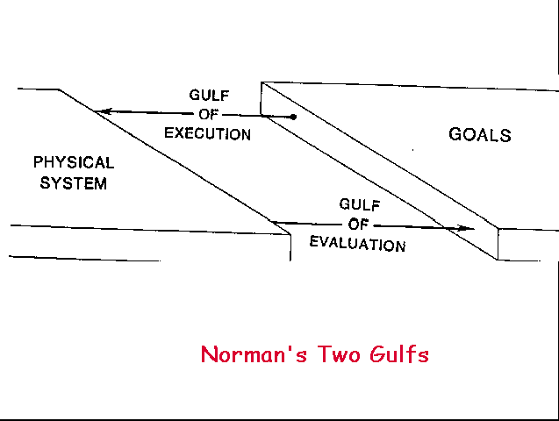
Interaction Gulfs

Slide 8
To be successful
Interface must communicate its abilities.
  What tasks are available to the user?
  How are they realized?
Interface must communicate state.
  Let the user know what is going on.
  What has happened.
User can then make an informed decision regarding the “next step” toward their goal state.

Slide 9
Part 2
The Players

Slide 10
Our Culture
The user
Users tend to accept for the most part what they are given.
  It is hard to use …
    Maybe it is supposed to be like that.
    Maybe I need to learn more.
    I can complain but who will listen?
    It does what it is supposed to…
    There is nothing better so I will …
    Management said so …
  Naive users who don’t understand there is something better out there.

Slide 11
Our Culture
The user
  Accept what they are given.
    Resistant to future change.
    Habits have formed.
  Sometimes have no vision of what can be.
    They are told what can and can’t work.
    It is not their job to know what can be.
  Are not equipped to design the next interface.

Slide 12
Our Culture
The developer/programmer
Responsible for code development.
  Ownership
    Code.
      Have the understanding.
    Thus of the interface.
    Who is to say they don’t, most users nor managers don’t program.
    Technical knowledge.
    Trained to be Engineers
      Is it error free.
      Does it compute properly.
      Is the software maintainable.
      Is it usable? Sure it is, they can use it.

Slide 13
Our Culture
The developer/programmer
Fun
  Technical issues involving computers hold interest.
  This is why they are in the profession.
Satisfying
  Problem solving holds interest.
  Like a sport
    Train
    Compete
    Fail, then keep going until solved.

Slide 14
Homo Sapien vs. Homo Logicus
Like Simplicity
Like Success
  Goal minded
Focus on what is probable
  What is realistic
Doesn’t care about internals
Doesn’t really know or care about how the “thing” works, just that it will achieve their goal.
View s/w as a tool.
Normal, whatever that means.
Like Control
  Like Features
Like Understanding
  Inner workings
Focus on what is possible
  Edge Cases
Willing to invest time and energy to learn the system
Masters of knowledge
  Obsessive
  Technically proficient
View the s/w as a personal challenge.
Technical Jocks

Slide 15
Our Culture
The Manager
Interested in product delivery.
  Cost?
  Time horizon?
  Goals are company centred.
    Does it meet managements goals
Productivity means having developers and programmers producing code.
May not be equipped to challenge developers/programmers on design decisions.
  No ownership of code.
  Lack deep technical knowledge to challenge decisions.

Slide 16
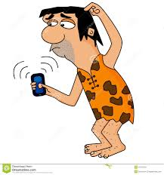
Culture Clash
Computers are technical gadgets.
  Some people like technical.
  Majority don’t, but accept they must use it.
Users tend to be Goal oriented.
  Completing the Goal is more important then knowing how.
Programmers tend to be detail oriented.
  Knowing how holds more interest then the goal.
  Having control over the how is even better.

Slide 17
Culture Clash
Managers don’t have complete influence over what code is produced.
  Programmers often can control the development and design due to there superior knowledge on the technical side.
Users are left in the dark
  No control or influence over the design.

Slide 18
Who is in Control
Managers are ill equipped to control what programmers actually produce.
  Regardless of formal design documents.
  Programmers can view and justify design changes.
  Design document becomes flexible.
Users have no influence
  Lack technical ability to compete with programmers.
The result is a product with interaction suited to the abilities of the developer.

Slide 19
Part 3
Current Themes in Interface Development
What has been tried.

Slide 20
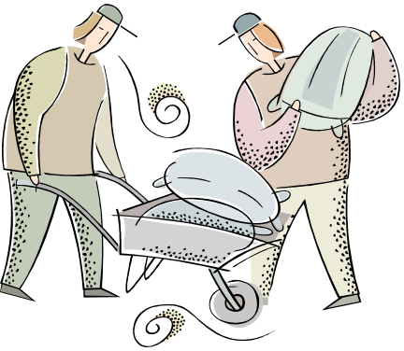
Why we have bad software
Lack of Design
  Design is done during coding.
  Code is a reflection of the design, Hmmmm?
  Programmer has influence over the design because they have ownership of the code.
    What they say carries weight.
    Can’t work, won’t work, won’t try
      That means work for me.
Code is like pouring concrete
  Once written, hard to get rid of or change.
  Expensive ($$$, time).
  Who wants to go through hours of hard work away, programmers don’t.
    Code reuse, square peg in round hole.

Slide 21
Why we have bad software
Programmers like features
  The software must also have lots of features.
  Software ends up with lots of controls.
Squeaky wheel
  Users squawk
    Management decides to cut the chatter.
    New features are added.
    Result is FeatureWare.
    Product becomes unusable.
    Each individual user’s wishes and biases are represented in one application.
    Lack of cohesiveness.

Slide 22

FeatureWare
Features are a reflection of individual wants, needs and biases.
New features added after an initial design causes instability in usability.
After a number of features are added the software becomes unwieldy.
  Hard to use
  End up with a house of cards.
Management and 1 user is happy.
S/W written from the start to be feature
loaded is no better. Tends not to support
any particular theme.
  When it tries to be everything to everybody, it is nothing to nobody.

Slide 23
Iterative Releases
Let user’s opinions dictate the updates.
Testing on users yields only marginal improvement.
Only after many releases does the s/w become reasonably usable.
Degenerates to feature ware.
  AKA Microsoft
Ver 1.0
Ver 1.1
Ver 1.11
Ver 2.0
Ver 2.01
Ver 2.03
…
Ver 5.01 SP5

Slide 24
User Interface Designed Last
Common practice is to engineer the application to meet business and technical needs.
  Hardware consideration.
  Performance consideration.
  Integration with existing systems.
  Data accuracy.
  System requirements.
We forgot the interface!
  Added after all else has been design.
  Interface is now restricted to perform in accordance to the underlying structure.
  Often reflects tasks which can be performed by the software.
  Results in featureware.

Slide 25

The Interface Cosmetologist
Design of Application and Interface has been completed by the programming team.
  Often is implemented.
Interface specialist is given the task to:
  Create the interface.
  Suggest changes.
    Only cosmetic changes possible.
    No chance to alter interface
    behaviour.
Also know as a Software Mortician

Slide 26
Design Team Includes Users
Having all, some or one user on the team is not feasible.
  Selected users are already biased by what was.
  Tend to only represent their needs.
    Features
  Tend not to articulate their goals well to the design team.
  Costly.

Slide 27
Part 4
The Solution

Slide 28
What is needed
Management
  Needs control over the design process.
  A process which supports a time line.
  Stabilizes cost.
  Can control the design and implementation.
Users
  Get software which is usable.
    Designed for Homo Sapien.
    Goal oriented.
  Make the experience of using the software pleasant.

Slide 29
What is needed
Programmers
  Allowed to implement to their harts content.
    But driven by a design chiseled into stone.
    No design work.
    Happy because they do what they are best at.
      Solving problems.

Slide 30
Persona
Users will be the ultimate benefactors of the software.
Accurate descriptions of who the users are:
  Habits
  Goals, what they want to accomplish.
  Behaviors
  Interests
  Background
    Educational
    Life experience
    Jobs
  Find out as much about the users a possible.

Slide 31
Personas
Persona Development
Develop fictitious personalities which represent real users.
  Based on behaviour.
  Goals, skills, attitudes.
  Collected during the research
Gives focus to the design
  We design for the persona
    Feature inclusion is based on needs of users, not perceived needs of designers.
  Ensures we provide for the users
    But not what we as designers or developers think should be included.
    Eliminates a design which is feature based.

Slide 32
Personas
Persona Development
Give the persona
  a real name.
  a real background
  age
  sex
  education
  experience etc.

Slide 33
Personas.
Goals of the persona (No more the 4)
  Life Goals (personal goals)
    Home by 5:00 (maybe useful)
  Experience Goals
    Not feeling stupid
    Having fun.
  End goals
    What they want to accomplish
Context of use
  Goals should be context specific, not general.
Ideal Process
Ideal Outcome
What they might put up with. (if it is not ideal).

Slide 34
Persona
Create a set of fabricated users based on the data collected.
  Cover the range of possible people who will be interacting with the software.
  Duplicates are allowed.
  Mutually exclusive personas are not needed.
  Must be realistic.
    Backed up by user research.
  Can include personal information which gives life to the user.

Slide 35
Example Problem
Brock Computer Science wishes to attract students for its masters program.
A website will be developed.
What content do we need?
What is the most important information?

Slide 36

Mary Elliot
Bio:
  Has graduated top of her class from math and computer science Acadia. Has many academic achievements including an NSERC student research scholarship. Participated in local and regional ACM contests.
  Day to Day activities include team sports, jogging and reading.
Personal Goal:
  Achieve a high education with a stable job in a good community to raise a family.
  Continue academia.
Immediate Goals:
  Enroll in an MSc. Program focusing on Genetic algorithm research with application to Data Mining.
  Aiming to complete the program in 2 years.
Habits & Behavior:
  Likes to work late
  Does get distracted easily
  Likes to socialize
  Likes to travel
Age 23
Single
Born: Halifax

Slide 37

Ahmed Nazzim
Bio:
  Has worked many odd jobs to help finance his education. Currently working as a research assistant for Professor Baltar researching cybernetics.
  Worked at the local observatory
  Day to Day activities include playing cards and biking.
Personal Goal:
  Move out of Kansas to a more progressive area with a night life.
Immediate Goals:
  Locate a University with a MSc program which has funding opportunities.
  Aiming to complete the program in 2 years.
Habits & Behavior:
  Hard worker.
  Very focused.
  Likes a social life.
  Flexible when it comes to research interests.
Age 21
Single
Born: Topeka, Kansas

Slide 38





Sorting the Personas.
Strive to generate 15 to 25 persona
  Each will be unique.
  Group these persona so that groups with common traits emerge.
    Some persona will complement others.
    Some will be a sub set of others.

Slide 39
Primary Persona
That persona which must be designed for.
  If the interface does not support this persona then we are loosing customer(s).
Assume that an interface can be designed where the secondary personas can adapt to the primary’s needs.
Justify and verify that the correct persona has been chosen.

Slide 40
Primary Persona
An interface is then created which directly supports the goals of the primary persona.
  Secondary control supports secondary persona.
If multiple primary persona are identified
  A unique interface is created for each.
The question of what and why has been answered.
Designer now gets creative
  Sorts out the how.

Slide 41
The Design
Designer expertise uses experience and intuition to determine an appropriate interface which supports the people parameters.
Iteration over the design takes place between:
  Design team.
  Product customer.

Slide 42
The Design
Once a design has been finalized it is carved in stone.
  Blue Print
    How the interface should look.
    How the interface should behave.
    What the interface supports.
Blue Print is given to the programmers

Slide 43
What has been solved
Management is happy
  A blue print means that costing and time expenditures can be predicted and substantiated.
  Code which is written supports the final product.
  Control is out of the programmers hands.
    No thinking just coding.
    Each design decision can be justified.
      Based on the persona
    No Homo-Logicus features will be added.

Slide 44
What has been solved
Programmers are happy
  Some novel interfaces require some deep thought
    Expert coding skills.
    A challenge for programmers.
  Don’t have to deal with users.

Slide 45
What has been solved
Users are happy
  Get a product which was designed with them in mind.
  Goal oriented.
  Works right the first time.
    No patching
    No added features

Slide 46
What a Persona Accomplishes
Defines who are we designing for.
What we are designing.
How it will be designed.
Verification that the design works.

Slide 47
The End
Any Questions?

